Slide 1
502045
Software Engineering
Chapter 07
Lesson 09: Code Quality

Slide 2
Code Quality
Agenda
Review Process
Common Defects

Slide 3
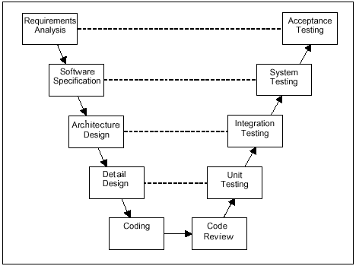
Review Process - Where the Coding is?

Slide 4
Review Process – The Quality Triangle

Slide 5
Review Process - The UR-RS gaps
The gap is likely to include:
Wrong interpretation of requirement and ambiguity in the specification.
Requirements identified after development commenced [started].
Changes to specified requirements identified after development commenced
Requirement ignored by the developers because they were too difficult to implement.

Slide 6
Review Process - The Software-UR Gap
The gap occurs because the software doesn’t satisfy the user requirements
The size of the gap is directly dependent on the side of other 2 sides of triangle

Slide 7
Review Process - Closing gaps between 3 views
Static test:
Review: online/offline
Inspection
Dynamic test:
Unit Test
Integration Test
System Test
Acceptance Test

Slide 8
Common Defects & Practices Hard code constants
Issue with giving a fixed value in codes, for example:
dgrView.PageSize = 10;
The problem occurs when you should change these values multiple times!!!
Preventive Action: define constants in the common constant module or in a configure files

Slide 9
Common Defects & Practices Array Index Start from 0
Issue with below C-Language codes?
int i, a[10];
for (i=1; i<=10; i++) a[i] = 0;

Slide 10
Common Defects & Practices The Dangling else Problem
Issue with below C-Language codes?
if (x == 0)
if (y == 0) error();
else {
z = x + y;
f (&z);
}

Slide 11
Common Defects & Practices Null Pointer Exception
Issue: the developer got Null-Pointer-Exception run-time error, while he/she did not detect that when compiling the codes
pPointer->member = 1;
strReturn = objDoc.SelectNodes(strName);
Cause: the developer does not check null or think about null object before accessing object's value.
Preventive: Should check null before accessing object or pointer before using its member
If ( pPointer != NULL ) pPointer->member = 1;
If (objDoc != NULL)
strReturn = objDoc.SelectNodes(strName);

Slide 12
Common Defects & Practices Detect Common Defects Sample
public bool IsValidLogin(string userName, string password) {
SqlConnection con = null;
SqlCommand cmd = null;
bool result = false;
try {
con = new SqlConnection(DB_CONNECTION);
con.Open();
string cmdtext = string.Format("SELECT * FROM [Users] WHERE [Account]='{0}' AND [Password]='{1}' “, userName, password);
cmd = new SqlCommand(cmdtext);
cmd.Connection = con;
cmd.CommandType = CommandType.Text;
result= cmd.ExecuteReader().HasRows;
cmd.Dispose();
con.Dispose();
return result;
}
catch (SqlException) {
return false;
}
}

Slide 13
Common Defects & Practices Programming Practices 1
Issue with variables or create objects in Loop?
for (int i=0; i<dt.Rows.Count-1; i++)
{
string strName;
strName = dt.Rows[i]["Name"].ToString();
//do something here
}
Impact to the application performance!!!
Cause: memory is allocated repeatedly.

Slide 14
Common Defects & Practices Programming Practices 2
Code redundant issues:
Create new Object while we can reuse the object in previous command:
BeanXXX bean = new BeanXXX();
bean = objectYYY.getBeanXXX();
Variables are declared in based class but it is not used

Slide 15

Common Defects & Practices Programming Practices 3
Avoid using an object to access a static variable or method. Use a class name instead.
Avoid assigning several variables to the same value in a single statement.
fooBar.fChar = barFoo.lchar = 'c'; // AVOID!

Slide 16
Common Defects & Practices Programming Practices 4
Do not use the assignment operator in a place
if (c++ = d++) { // AVOID!
...
}
should be written as:
if ((c++ = d++) != 0) {
...
}
Do not use embedded assignments in an attempt to improve run-time performance.
d = (a = b + c) + r;

Slide 17
Common Defects & Practices Programming Practices 5
File operations: file read operations must be restricted to a minimum
Clear content of big structure after use: always clear() the content of Collection/Map objects after use
Be economical when creating new objects
In program language that has no garbage collector (i.e C, C++): free allocated memory after use:
{ double* A = malloc(sizeof(double)*M*N); for(int i = 0; i < M*N; i++){ A[i] = i; } }
memory leak: forgot to call free(A);
common problem in C, C++

Slide 18
Common Defects & Practices Programming Practices 6
Use parentheses liberally in expressions involving mixed operators to avoid operator precedence problems
if (a == b && c == d) // AVOID!
if ((a == b) && (c == d)) // RIGHT
Try to make the structure of your program match the intent [goal], for example:
if (booleanExpression) {
return true;
} else {
return false;
}
should instead be written as
return booleanExpression;

Slide 19


